Slide 1
Capstone Project
HR Analytics about Employee
Turnover and its prediction
Omar A. Shakir Al Faiadh
201735167
Advisor : Dr. Subhadip Pal

Slide 2
Contents
Chapter 1: Introduction.
Chapter 2: Literature Review.
Chapter 3: About Data and Data exploration.
Chapter 4: Methodology.
Chapter 5: Models and Results.
Chapter 6: Conclusion.
References.

Slide 3
Chapter 1: Introduction.
1.1 Overview
1.2 Terminology and types of Turnover.
1.3 Why do we want to decrease employee turnover rates?
1.4 problem statement and objectives.

Slide 4
Overview of Employee Turnover and Retention
Employee turnover is a crucial issue that affects organizational stability and performance.
Understanding the causes of turnover through identification and analysis helps reduce the rates of turnover effectively.
Predicting turnover enables organizations to get to the root causes and implement solutions before employees actually leave.

Slide 5
Terminology and Types of Employee Turnover
Definition of Employee Turnover in past and present:
Past: Intention to leave as a deliberate desire to exit the organization.
Present: Desire to leave a position for another job or role, either within the same organization or elsewhere.
Types of Turnover:
Based on Will to Leave:
Voluntary: Initiated by the employee.
Functional: When a poor performer quits.
Involuntary: When the employer initiates separation for either poor performance, violation of policies, or absenteeism.
Internal vs. External:
Internal: Employee changed their role in the same company.
External: The employee shifted to another company.
Based on Skills:
Skilled: Less frequent, but more impactful.
Unskilled: Easy to replace; very little loss in productivity.

Slide 6
Why Reduce Employee Turnover Rates?
Due to High Employee Turnover:
-Increased cost of recruitment, training, and development.
-Loss of productivity and performance during transition periods.
-Remaining employees will suffer from additional stress and overwork, which may lower performance level.
Consequences:
1-Cost and Time.
2-Threatens Growth and Survival.
3-Production and Performance.
4-Skill and Knowledge Loss.

Slide 7
Problem Statement and Objectives
Problem Statement:
Employee turnover is a critical challenge for organizations, impacting productivity and profitability. Understanding turnover causes and predicting at-risk employees are essential to address the issue proactively.
Thesis Objectives:
Explore the relationship between different variables and employee turnover.
Create predictive models using machine learning that will identify employees at risk of leaving.
Compare the predictive models to find out which one is the best for turnover prediction.

Slide 8
Chapter 2: Literature Review.
2.1 Factors That Influence Employee Turnover.
2.2 How to Avoid Employee Turnover?
2.3 challenges and recommendations.
2.4 Techniques used in previous research.
2.5 Areas of Improvement in Employee Turnover Research

Slide 9
Factors Influencing Employee Turnover
Overview
Predictors of turnover change with the evolution in human behavior and organizational dynamics.
There are different levels at which turnover can be influenced: Individual, Team, Organizational, and Market-level.
Key Factors:
Individual Level: Job satisfaction, stress, wages, unmet expectations, work-life balance, career growth, and external job alternatives.
Team Level: Emotional support, interpersonal relationships, and department-specific dynamics.
Organizational-Level Factors:
Poor leadership, low wages, lack of training, job dissatisfaction, poor work-life balance, and limited career growth. Organizational justice and employee engagement help mitigate turnover.

Slide 10
Factors Influencing Employee Turnover
Market-Level Factors:
Influenced by unemployment rates, job opportunities, wages, and trade unions. Economic trends impact turnover rates indirectly.
Mediating Factors:
Social Capital: Enhances satisfaction, which in turn reduces turnover.
Employee Fit, Link, and Sacrifice: Predict job retention likelihood.
Individual factors usually mediate team and organizational influences.

Slide 11
Effective Strategies To Reduce Employee Turnover Rstio
Engagement of employees in decision-making and solving problems.
Supportive leadership and opportunities for career growth.
Fair wage, satisfaction with the job, and balance in work-life.
High level of employee engagement and high satisfaction level lead to lower turnover intentions.
Mediators connect the organizational dynamics with the personal decisions.

Slide 12
Reducing Employee Turnover
Key Focus Areas:
Interpersonal Relationships: Good relations, trust, and respect translate into increased satisfaction and decreased turnover.
Understanding Employee Needs: Meeting the physical, emotional, and professional needs of employees increases retention.

Slide 13
Strategies to Reduce Turnover
Effective Retention Strategies:
Strong management systems and training opportunities.
Free flow of communication and empathetic culture.
Job satisfaction through role fit, rewards, and benefits.
Employee engagement through interactive activities and career growth.
Managerial Behaviors:
Proactive coaching and addressing challenges with the employees.
Promote well-being and work-life balance.

Slide 14
Employee Engagement
& Job Embeddedness
Engagement Strategies:
Facilitate employee happiness through opportunities and skill alignment.
Encourage work-life balance and career growth.
Job Embeddedness:
Align with community and lifestyle.
Lower recruitment and training costs due to longer retention.
Impact:
Commitment high, turnover intentions low.

Slide 15
Enhancement of Job Satisfaction
& Retention
Work Environment:
Positive relationships and job satisfaction diminish stress.
Match jobs to employee competencies for more motivation and productivity.
Holistic Retention Strategies:
Implement High-Performance Work Systems.
Improve employee competencies and motivation to increase satisfaction.
Outcome:
Improved job satisfaction, less absenteeism, and lower labor turnover.

Slide 16
Challenges and Recommendations
Challenges:
Limited scope of the present data to stand in for comprehensive analysis.
The longitudinal studies in detail are highly required for analyzing the relations over time.
Recommendations:
Longitudinal survey design should be used to make in-depth analysis of variables under study.
Datasets from multiple regions will enable broader comprehension of social capital's impact on turnover intentions.

Slide 17

Techniques Used in Employee
Turnover Prediction
Sample of Table 1: Most Techniques used.
Reference number. | Authors | Technique | Target variable | Type
2 | Lazzari et al. (2022) | K-nearest neighbor (KNN), Decision Trees (DT), Logistic Regression (LR), Random Forests (RF), XGBoost (XGB), LightGBM (LGBM), TabNet (TABNET) | the intention of the respondent to leave the organization within the next three months. | categorical
7 | Jin et al. (2023) | Random Survival Forest (RSF) for survival analysis and Random Forest (RF) for turnover prediction, leading to the RFRSF algorithm. | the turnover status of employees. | Categorical
12 | Ramlawati et al. (2021) | Partial Least Square (PLS) approach, Structural Equation Modeling (SEM) | Turnover Intention. | categorical.
15 | Bayad Jamal Ali et al. (2021) | Factor analysis, regression analysis | turnover intention. | Categorical

Slide 18
Techniques Used in Employee
Turnover Prediction
Summary of Results:
Most Used Techniques
SEM-Structural Equation Modeling: 21 articles, Regression Analysis: 15 articles, Random Forest (RF): 5 articles.
Other Techniques
PLS, CFA, PLS-SEM: 4 articles each, Decision Tree (DT), Pearson Correlation: 3 articles each, XGB, OLS: 2 articles each.
Less Used Techniques
KNN, LFBM, TABNET, RSF, AMOS, Bootstrapping, Factor Analysis, etc.: These techniques were used once in various studies.
Results combine statistical methods and machine learning models; the most prominent is SEM in employee turnover prediction and analysis.

Slide 19
Areas of Improvement in
Employee Turnover Research
The Need for Consensus in Identifying Key Factors:
Most studies establish factors that influence employee turnover, but there is no agreement on which factors are most influential.
Exploring Contemporary Machine Learning Procedure:
A limited number of studies use machine learning techniques for employee turnover prediction.
Comparative Studies for Comprehensive Analysis:
Very few studies are found comparing different machine learning models to find the best predictive model for employee turnover.

Slide 20
Chapter 3: About Data and Data exploration.
3.1 Introduction for data.
3.2 About Data and Summary Statistics.
3.3 Visualizations.
3.4 Missing data.
3.5 Correlation Analysis.

Slide 21
Introduction For Dataset
Dataset Overview:
This is a dataset based on employees for HR Analytics. It was published in Kaggle and it is under CC0: Public Domain License.
Variables:
Satisfaction level, Number of Projects, Average Monthly Hours, Years at Company, Promotion in Last 5 Years, Department, Salary level, Last Performance Rating, had work accident, and has left company.
Table 2: Header of first 5 samples.
Row Number | satisfaction_level | last_performance_rating | number_of_projects | avg_monthly_hours | years_at_company
1 | 0.38 | 0.53 | 2 | 157 | 3
2 | 0.8 | 0.86 | 5 | 262 | 6
3 | 0.11 | 0.88 | 7 | 272 | 4
4 | 0.72 | 0.87 | 5 | 223 | 5
5 | 0.37 | 0.52 | 2 | 159 | 3
had_work_accident | has_left_company | promoted_in_last_5_years | Department | salary_level
0 | 1 | 0 | sales | low
0 | 1 | 0 | sales | medium
0 | 1 | 0 | sales | medium
0 | 1 | 0 | sales | low
0 | 1 | 0 | sales | low

Slide 22
About Dataset Variables
Satisfaction Level:
Description: Self-reported job satisfaction level
Type: Numerical (0-1)
Range: 0 (low) to 1 (high)
Last Performance Rating:
Description: Employee's last performance score
Type: Numerical (0-1)
Range: 0 (lowest) to 1 (highest)
Number of Projects:
Description: Total number of projects worked on
Type: Numerical (Integer)
Range: Higher values indicate more projects
Average Monthly Hours:
Description: Average work hours per month
Type: Numerical (Continuous Integer)

Slide 23
About Dataset Variables
Years at Company:
Description: Employee's tenure at the company (in years)
Type: Numerical (Continuous Float)
Had Work Accident:
Description: Indicates if employee had a work accident
Type: Categorical (Binary 0 or 1)
Promoted in Last 5 Years:
Description: Whether the employee was promoted in the last 5 years
Type: Categorical (Binary 0 or 1)

Slide 24
About Dataset Variables
Department:
Description: Employee’s department
Type: Categorical (Integer Encoded)
Range: 0-9 representing various departments
Salary Level:
Description: Employee’s salary level
Type: Categorical (Encoded)
Range: 0 (Low), 1 (Medium), 2 (High)
Has Left Company (Target Feature):
Description: Whether the employee left the company
Type: Categorical (Binary 0 or 1)

Slide 25
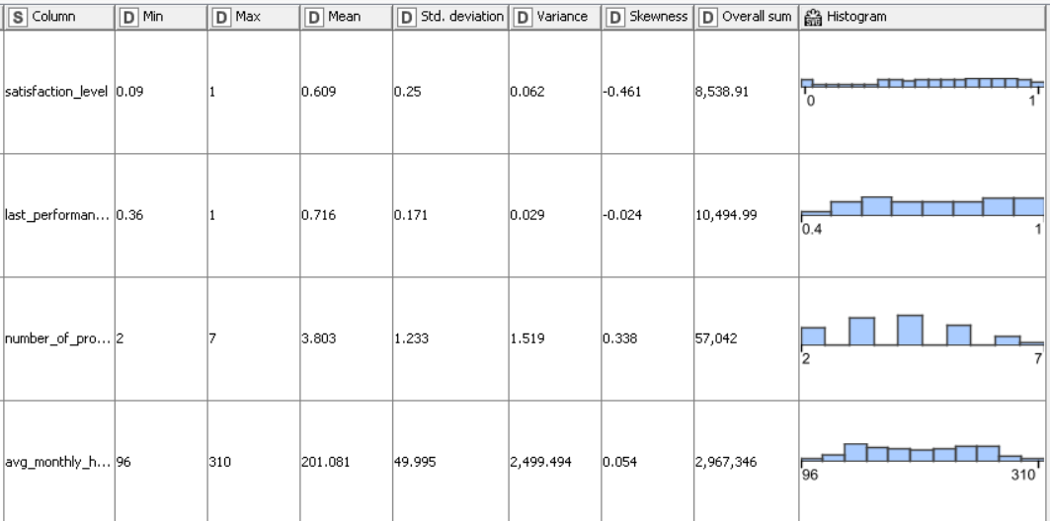
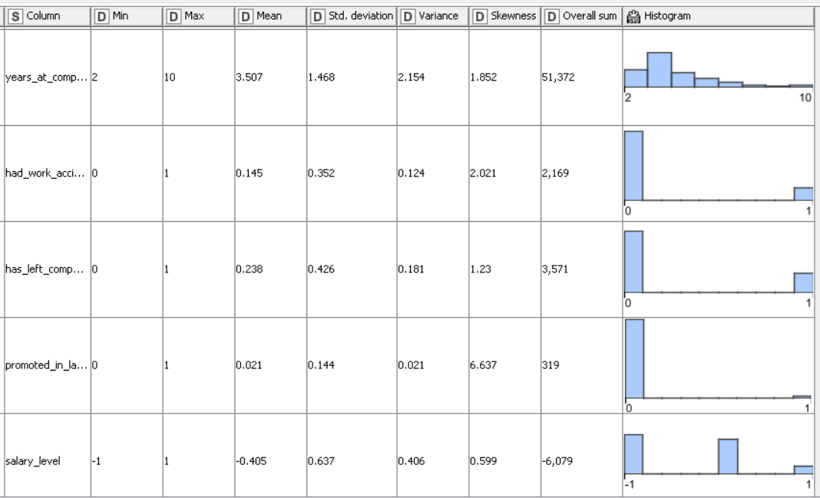
Summary Statistics of Dataset
Figure 1: summary statistics.
Figure 2: continuous of summary statistics

Slide 26
Summary Statistics of Dataset
Satisfaction Level:
Range: 0.09 to 1 (0% to 100% Satisfaction)
Mean: 0.609 (60.9% Satisfaction)
Standard Deviation: 0.25 (Moderate variability)
Skewness: -0.461 (Slight left skew, indicating higher satisfaction)
Total Sum: 8,533.91 (Total satisfaction score across employees)
Last Performance Rating:
Range: 0.36 to 1 (0% to 100% Performance)
Mean: 0.716 (71.6% performance)
Standard Deviation: 0.171 (Low variability in performance scores)
Skewness: -0.024 (Symmetric distribution, indicating balanced performance levels)
Total Sum: 10,494.99 (Total performance score across employees)

Slide 27
Summary Statistics of Dataset
Number of Projects:
Range: 2 to 7 projects
Mean: 3.803 projects (Average number of projects per employee)
Standard Deviation: 1.233 (Moderate variability in projects handled)
Skewness: 0.338 (Slight right skew, indicating more employees worked on fewer projects)
Total Sum: 57,042 (Total number of projects handled by all employees)
Average Monthly Hours:
Range: 96 to 310 hours
Mean: 201.081 hours (Average monthly work hours per employee)
Standard Deviation: 49.995 (High variability in monthly work hours)
Skewness: 0.054 (Almost symmetric distribution, indicating a balanced spread of work hours)
Total Sum: 2,967,346 hours (Total work hours across employees)

Slide 28
Summary Statistics of Dataset
Years at Company:
Range: 2 to 10 years
Mean: 3.507 years (Average tenure of employees at the company)
Standard Deviation: 1.468 (Moderate variability in employee tenure)
Skewness: 1.852 (Strong right skew, indicating that most employees are relatively new)
Total Sum: 51,372 years (Total years worked by all employees)
Had Work Accident:
Range: 0 to 1 (0 = No, 1 = Yes)
Mean: 0.145 (14.5% of employees had a work accident)
Standard Deviation: 0.352 (Moderate variability in accident occurrences)
Skewness: 2.021 (Strong right skew, indicating most employees did not have accidents)
Total Sum: 2,169 (Total number of work accidents)

Slide 29
Summary Statistics of Dataset
Has Left Company:
Range: 0 to 1 (0 = Stayed, 1 = Left)
Mean: 0.238 (23.8% of employees left the company)
Standard Deviation: 0.426 (Moderate variability in turnover)
Skewness: 1.23 (Strong right skew, indicating that most employees stayed in the company)
Total Sum: 3,571 (Total number of employees who left the company)
Promoted in Last 5 Years:
Range: 0 to 1 (0 = No promotion, 1 = Promoted)
Mean: 0.021 (2.1% of employees were promoted in the last 5 years)
Standard Deviation: 0.144 (Low variability in promotion occurrences)
Skewness: 6.637 (Strong right skew, indicating promotions are rare)
Total Sum: 319 (Total number of employees promoted in the last 5 years)

Slide 30
Summary Statistics of Dataset
Salary Level:
Range: -1 to 1 (0 = Low, 1 = High)
Mean: -0.405 (Mostly low salary level)
Standard Deviation: 0.637 (Moderate variability in salary levels)
Skewness: 0.599 (Slight right skew, indicating a tendency toward low salaries)
Total Sum: -6,079 (Total salary value across employees)

Slide 31
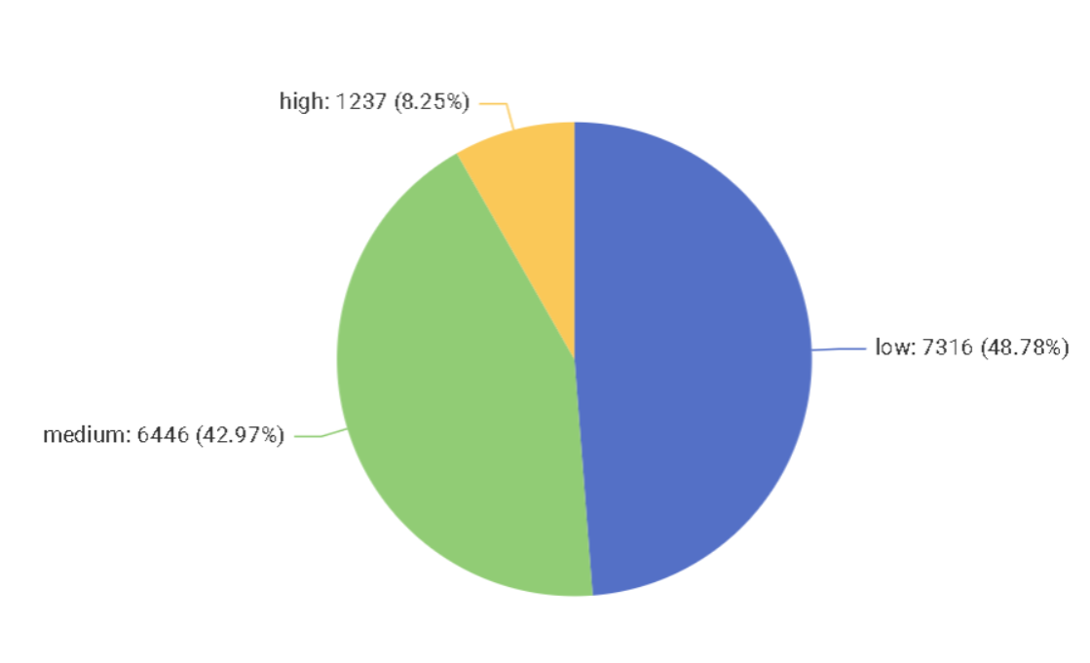
Employee Salary Distribution
Pie chart shows the distribution of employees according to salary grades: High, Medium, Low
Key Findings:
High Salary: 1,237 employees (8.25% of total).
Medium Salary: 6,446 employees (42.97% of total).
Low Salary: 7,316 employees (48.78% of total).
Figure 4: the percentage of people with high salaries, medium salaries, low salaries that we have in this dataset.

Slide 32
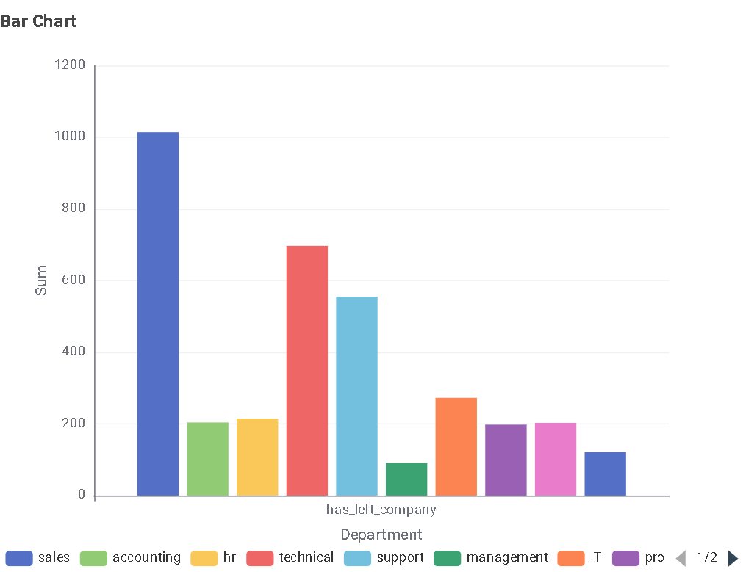

Department-wise Employee Turnover
The bar chart shows the department-wise distribution of employee turnover.
Key findings:
The Sales department had the highest number of turnovers.
The Management department had the lowest number of turnovers.
Figure 3: the total number of employee turnover within each department.

Slide 33
Missing Data
There was both, numerical and categorical missing values.
Numerical Variables:
Missing values were imputed by calculating the mean for each respective variable.
Categorical Variables:
Missing data was replaced with None to ensure smooth performance in KNIME nodes.

Slide 34
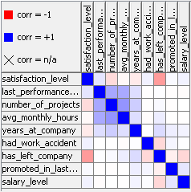
Correlation Matrix
Figure 5: Correlation Matrix.

Slide 35
Correlations with "Has Left Company"
Highest Correlation:
Satisfaction Level: -0.39
Interpretation: Negative correlation.
The lower the satisfaction level, the higher the possibility of leaving.
Weak Positive Correlation:
Years at Company: 0.14
Interpretation: Longer tenure slightly decreases the likelihood of leaving the company.
Weak Negative Correlations:
Salary Level: -0.16.
Interpretation: Higher salary level correlates to more employee turnover.
Had Work Accident: -0.16.
Interpretation: Employees who experienced work accidents are slightly more likely to leave.

Slide 36
Chapter 4: Methodology
4.1 What are the types of analysis that will be used?
4.2 Decision Tree.
4.3 Logistic regression.
4.4 Random Forest.
4.5 Neural Network.
4.6 K-Means.
4.7 The workflow on KNIME for the exploratory analysis and models.
4.8 Logistic regression based on k-means on KNIME.
4.9 Partitioning 60%-40% and 80%-20%.

Slide 37
KNIME
Neural Network
Random Forest
Decision Tree
Logistic Regression
Logistic Regression Based on K-Means

Slide 38
Types of Analysis Used
Exploratory Analysis:
Visualizations: Bar charts, pie charts, scatter plots to explore relationships with employee turnover.
Correlation Analysis : Measures strength between dependent variables and turnover.
Predictive Modeling:
Logistic Regression
Predicts turnover likelihood
Coefficients reveal most influential factors
2. Random Forest
Captures non-linear relationships and interactions

Slide 39
Types of Analysis Used
3. Neural Network
Advanced, deep learning technique for high-accuracy prediction
Decision Tree
Offers interpretable structure and decision paths
Logistic Regression Based on K-Means
Experimental model to improve logistic regression using clustering segmentation
Model Comparison:
Validation Method: Accuracy used to evaluate and compare all models
Goal: Identify the most effective model for predicting employee turnover

Slide 40
Decision Tree
A classification decision tree is built in memory.
Target attribute must be nominal.
Decision attributes can be numerical or nominal.
Splitting Rules:
Numerical Splits: Always binary (2 partitions at a split point).
Nominal Splits:
Binary: Divides values into two groups.
Multi-way: One outcome per nominal value.

Slide 41
Decision Tree
Split Quality Metrics:
Gini Index
Gain Ratio
Optimization Techniques:
Post-pruning using Minimum Description Length (MDL) principle to:
Reduce tree size
Improve accuracy
Performance:
Supports multi-threading for efficient use of multiple processors.

Slide 42
Logistic Regression
Definition: Predicts the probability that a sample belongs to a given class (e.g., spam vs. not spam).
Model Mechanics:
Computes a weighted sum of input features plus a bias term.
Applies the logistic (sigmoid) function to map the sum into a probability between 0 and 1.
Training Objective:
Optimize parameters (weights & bias) so that:
Correct classifications receive high probabilities.
Incorrect classifications receive low probabilities.
Advantages:
Produces class probability estimates, enhancing reliability and interpretability.
Versatile and widely used in both statistics and machine learning applications.

Slide 43
Random Forest
Versatile ensemble method for both classification and regression.
Builds multiple decision trees and aggregates their predictions.
Model Mechanics:
Bootstrap sampling: Each tree is trained on a random subset of rows (with replacement).
Feature sub setting: At each split, √m randomly chosen features are considered (m = total features).
Aggregation:
Classification: Majority vote across trees.
Regression: Average of tree predictions.

Slide 44
Random Forest
Advantages:
Reduces overfitting through randomness in data and features.
Handles high-dimensional datasets and resists noise.
Scalable to large data and supports varied feature types (bit, byte, double vectors).
Offers feature importance insights for interpretability.
Key Benefit:
Delivers robust, accurate predictions by combining the strengths of many decision trees.

Slide 45
Neural Network (Probabilistic Neural Network with DDA)
Implements a Probabilistic Neural Network (PNN) trained via Dynamic Decay Adjustment (DDA).
Model Construction:
Rule representation: Each rule is a high-dimensional Gaussian function.
Thresholds:
θ⁻ and θ⁺ adjust Gaussians to prevent overlap between classes.
Gaussian parameters:
Center vector: From first covered instance.
Standard deviation: Dynamically tuned to include non-conflicting examples.

Slide 46
Neural Network (Probabilistic Neural Network with DDA)
Data & Targets:
Inputs: Selected numerical features.
Targets: Single binary class column or multiple “degree” columns (0–1 range).
Training Output:
Generates a rule set and associated rule metrics.
Prediction Mechanism:
Matches each sample against generated rules and assigns 0 or 1 based on best rule fit.

Slide 47
K-Means Clustering
Unsupervised, crisp clustering assigning each data point to exactly one cluster.
Key Characteristics:
Predetermined k: Number of clusters set in advance.
Distance metric: Uses Euclidean distance to assign points to nearest centroid.
Iterative refinement:
1. Assign points to closest centroid
2. Recompute centroids based on current assignments
3. Repeat until assignments no longer change
Outcome:
Final cluster centers represent groups of similar data vectors.

Slide 48
KNIME
This project was mostly done on KNIME.
What is KNIME?
KNIME is a Visual workflow interface and an open-source platform used for data preprocessing, exploratory data analysis, machine learning, and data visualization.

Slide 49
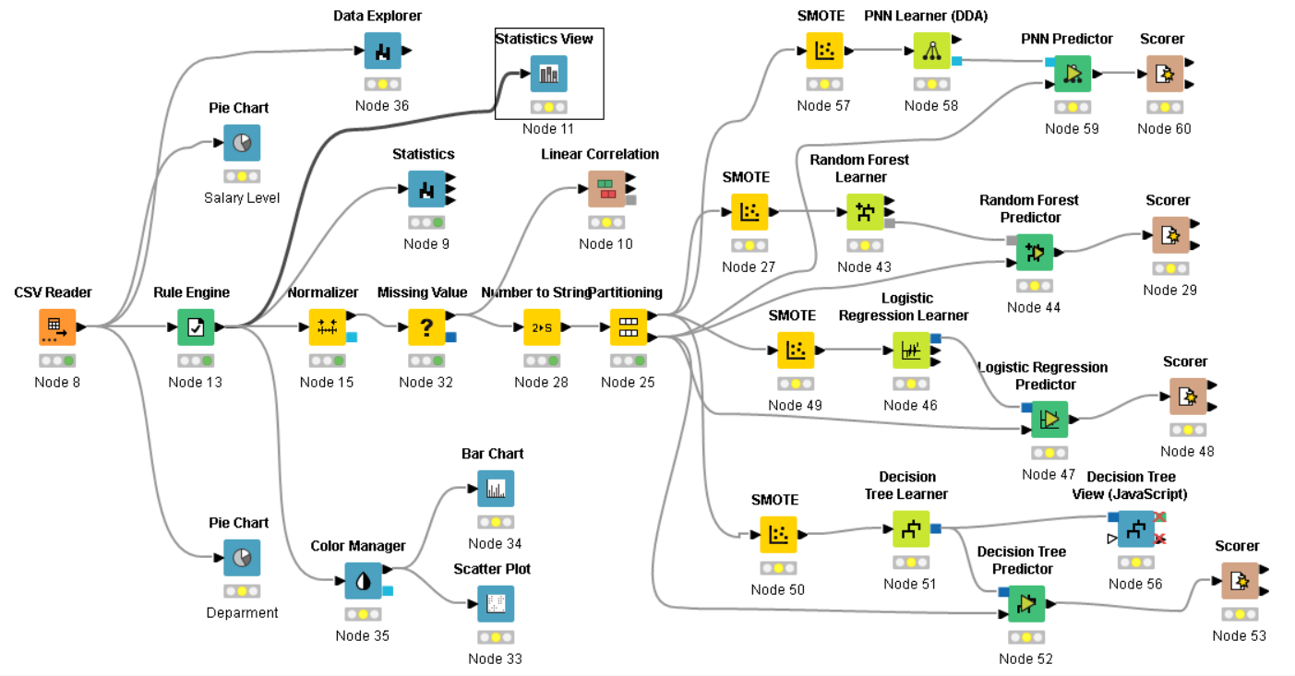
The workflow on KNIME for the expletory analysis and models.
Figure 6: Workflow on KNIME.

Slide 50
The workflow on KNIME for the expletory analysis and models
Initial Steps:
CSV Reader Node for input data
Rule Engine Node: Converted “left” values from yes/no to 0/1
Visualization Tools Used:
Statistics Node
Pie Chart Node
Bar Chart, Scatter Plot
Color Manager
Normalizer Node: Scaled numerical variables (range 0 to 1)
Missing Value Node:
Numerical: Mean replacement
Categorical: Replaced with “None”

Slide 51
The workflow on KNIME for the expletory analysis and models
Correlation Analysis:
Linear Correlation Node used after converting “left” to numeric
Data Conversion for Modeling:
Number to String Node: Converted “left” to categorical
Partitioning:
Partitioning Node Settings:
70% Training, 30% Testing
Stratified sampling based on “left” (to preserve class distribution)

Slide 52
The workflow on KNIME for the expletory analysis and models
Workflow Branches into four Paths:
Random Forest Path
SMOTE Node: Fixes class imbalance using k=5 nearest neighbors
Random Forest Learner (70%)
Random Forest Predictor (30%)
Scorer Node: Accuracy + Confusion Matrix
2. Logistic Regression Path
SMOTE Node (again)
Logistic Regression Learner (70%)
Logistic Regression Predictor (30%)
Scorer Node: Accuracy + Confusion Matrix

Slide 53
The workflow on KNIME for the expletory analysis and models
3-PNN:
PNN (Probabilistic Neural Network) Branch:
After data partitioning, a third modeling path was added using a PNN Learner (DDA).
SMOTE applied to address class imbalance in training data.
PNN used a memory-based classification approach via probability density estimation in multidimensional space.
PNN Predictor tested the model on the 30% partition.
Scorer Node evaluated accuracy, precision, recall, and confusion matrix.

Slide 54
The workflow on KNIME for the expletory analysis and models
4-Decision Tree:
Also used SMOTE on training data to handle imbalance.
Decision Tree Learner built the classification model.
Decision Tree Predictor applied model to test set.
Decision Tree View (JavaScript) enabled interactive visualization of the decision paths.
Scorer Node assessed model performance using standard metrics.

Slide 55
The workflow on KNIME for the expletory analysis and models
Imbalanced Data Problem:
“has_left_company” variable was imbalanced
SMOTE (Synthetic Minority Over-sampling Technique) used for oversampling
SMOTE Settings in KNIME:
Uses 5 nearest neighbors
Oversamples minority class only
Improves training set balance and model performance

Slide 56
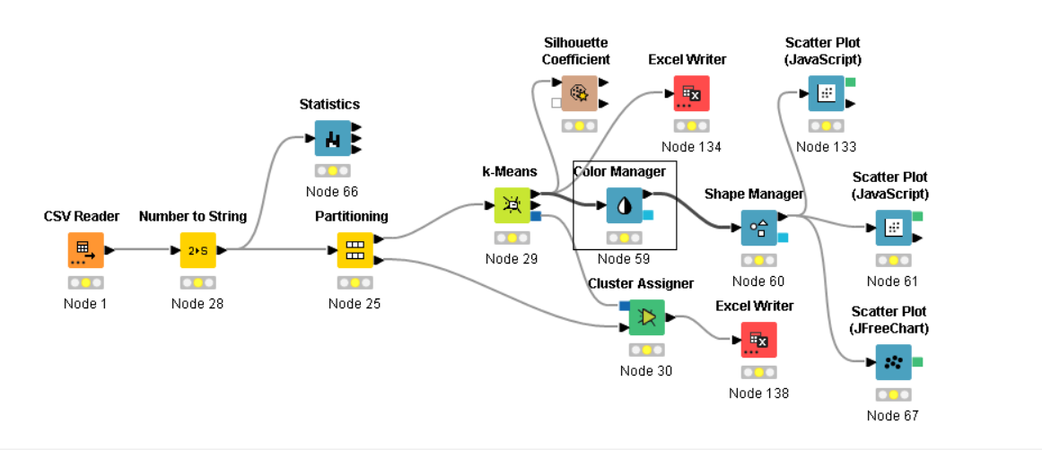
Logistic regression based on k-means on KNIME
Figure 7: KNIME workflow of performing K-Means.

Slide 57
Logistic regression based on k-means on KNIME
1. Data Import & Preprocessing
Loaded HR dataset (CSV Reader)
Converted numerical to categorical (Number to String)
Split data (Partitioning)
2. Exploratory Data Analysis
Generated summary statistics (Statistics Node)
3. Clustering with k-Means
Performed clustering (k-Means Node)
Assigned cluster labels (Cluster Assigner)

Slide 58
Logistic regression based on k-means on KNIME
4. Visualization & Evaluation
Visual styling (Color & Shape Manager)
Scatter plots (JavaScript & JFreeChart)
Cluster quality: Silhouette Coefficient
5. Exporting Results
Saved grouped data (Excel Writer)

Slide 59
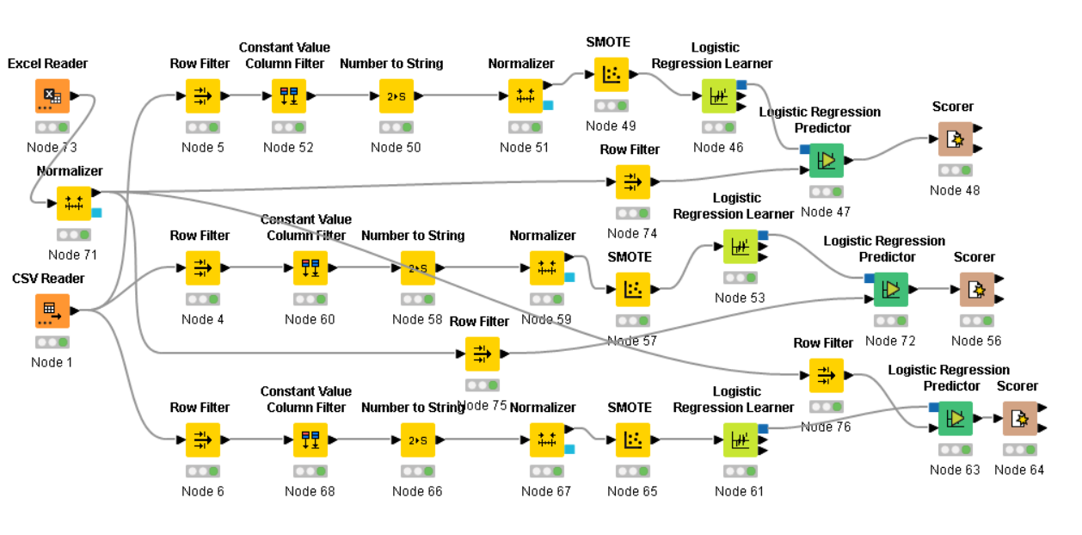
Logistic regression based on k-means on KNIME
Figure 8: KNIME workflow of performing Logistic Regression based on K-Means.

Slide 60
Logistic regression based on k-means on KNIME
1. Data Input
CSV Reader (Node 1): Trained data used (K-Means applied), testing data added later (Node 69) for consistency across models.
2. Preprocessing Steps
Row Filtering (Nodes 4, 5, etc.):
Isolate clusters (e.g., keep only Cluster 0, 1, or 2 per branch)
Remove Redundant Columns: Constant Value Column Filter (Nodes 52, 60, etc.)
Format Adjustments: Number to String conversion (Nodes 50, 58, etc.)
Normalization: Scale numeric data for modeling (Nodes 51, 59, etc.)
Class Balancing: Apply SMOTE for synthetic oversampling of minority class

Slide 61
Logistic regression based on k-means on KNIME
3. Testing Data Setup
CSV Reader (Node 69):Recall consistent testing data from earlier step
Partitioning: Split for model training and evaluation
4. Model Training
Logistic Regression Learner (Nodes 53, 74)
Train model on cleaned, clustered, and balanced data
5. Prediction & Evaluation
Logistic Regression Predictor (Nodes 47, 72)
Scorer Nodes (48, 56, etc.): Evaluate prediction accuracy
This workflow tries to enhance logistic regression’s accuracy by segmenting data with k-means clustering.

Slide 62
Partitioning 60%-40% and 80%-20%
Objective:
To make sure that partitioning ratios do not bias model accuracy comparisons for models’ employee turnover prediction.
Methodology:
Reused identical workflows and settings as established earlier.
Conducted two additional experiments with different data splits:
60% training / 40% testing
80% training / 20% testing

Slide 63
Chapter 5: Models and Results.
5.1 Logistic Regression Results.
5.2 Random Forest results.
5.3 Decision Tree.
5.4 K-Means.
5.5 Neural Network.
5.6 Logistic Regression based on K-Means Results.
5.7 Models Comparison.

Slide 64
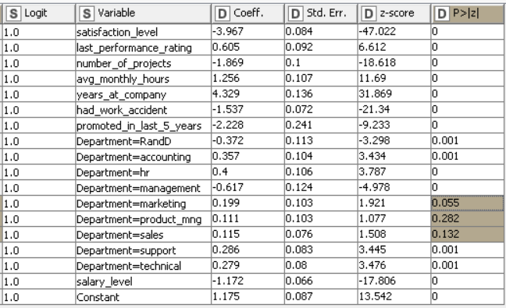
Logistic Regression Coefficients
Figure 9: Coefficients of the variables of logistic regression model.

Slide 65
Logistic Regression Coefficients.
Any numerical variable with p-value < 0.05 should be excluded from the model.
Marketing, Product Management, and Sales departments have p-values < 0.05. They are not going to be removed because Department variable had some categories lower than p-values < 0.05 (provides useful information)
Higher coefficients = higher importance.
Most important variable is Years at Company with a coefficient of 4.329.

Slide 66
Employee Turnover Prediction Results
Table 3: Confusion Matrix.
 | 1.0 | 0.0
1.0 | 885 | 828
0.0 | 186 | 2601
Table 4: Accuracy scores.
Row ID | True Positives | False Positives | True Negatives | False Negatives | Recall | Precision | sensitivity | Specificity | F-measure | Accuracy
1.0 | 885 | 186 | 2601 | 828 | 0.517 | 0.826 | 0.517 | 0.933 | 0.636
0.0 | 2601 | 828 | 885 | 186 | 0.933 | 0.759 | 0.933 | 0.517 | 0.837
Overall |  |  |  |  |  |  |  |  |  | 0.775
.
Table 3 and Table 4 show that the model has 77.5% accuracy in predicting employees Turnover.

Slide 67
Random Forest
All independent variables included
Split criterion: Gini Index (measures node impurity)
Tree depth: Maximum of 12 levels (to prevent overfitting)
Minimum samples per leaf node: 5
Number of trees: 200 (balanced performance and cost)
Reproducibility: Static random seed used

Slide 68
Random Forest Results
Table 5: Confusion Matrix 2.
Row ID | 1.0 | 0.0
1.0 | 1013 | 58
0.0 | 24 | 3405
Table 6: Accuracy Scores 2.
Row ID | True Positives | False Positives | True Negatives | False Negatives | Recall | Precision | sensitivity | Specificity | F-measure | Accuracy
1.0 | 1013 | 24 | 3405 | 58 | 0.946 | 0.977 | 0.946 | 0.993 | 0.961
0.0 | 3405 | 58 | 1013 | 24 | 0.993 | 0.983 | 0.993 | 0.946 | 0.988
Overall |  |  |  |  |  |  |  |  |  | 0.982
Tables 5 and 6 show 98.2% accuracy in predicting employee turnover.

Slide 69
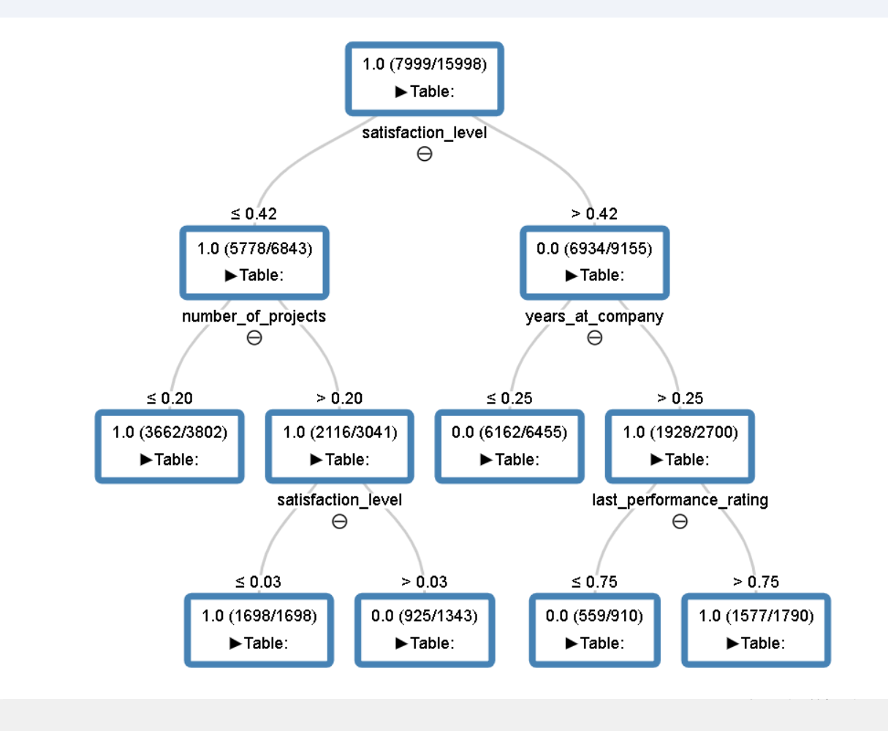
Decision Tree
Figure 10: Decision Tree Model.

Slide 70
Decision Tree
Pruning method: NPL pruning applied to prevent overfitting.
Feature selection based on Gini Index.
Model Structure.
Root node:`satisfaction_level` (threshold: 0.42)
If `satisfaction_level ≤ 0.42`:
Move to `number_of_projects` (threshold: 0.20)
Fewer projects → Higher chance of leaving (Prediction = 1.0)
If `satisfaction_level > 0.42`:
Move to `years_at_company` (threshold: 0.25)
Fewer years → Likely to stay (0.0); more years → Likely to leave (1.0)

Slide 71
Decision Tree
Further split:
`last_performance_rating` (threshold: 0.75)
Lower rating → Stay
Higher rating → Higher risk of leaving
Reveals the most important factors influencing employee turnover.

Slide 72
Decision Tree Results
Table 8: confusion matrix of decision tree.
Row ID | 1.0 | 0.0
1.0 | 955 | 122
0.0 | 116 | 3307
Table 9: Accuracy table.
Row ID | True Positives | False Positives | True Negatives | False Negatives | Recall | Precision | sensitivity | Specificity | F-measure | Accuracy
1.0 | 955 | 116 | 3307 | 122 | 0.887 | 0.892 | 0.887 | 0.966 | 0.889
0.0 | 3307 | 122 | 955 | 116 | 0.966 | 0.964 | 0.966 | 0.887 | 0.965
Overall |  |  |  |  |  |  |  |  |  | 0.947

Slide 73
K-Means
Table 7: Finding optimal k using Overall Silhouette Coefficients.
K | Overall Silhouette Coefficient
2 | 0.316
3 | 0.43
4 | 0.428
5 | 0.418
6 | 0.402
7 | 0.424
8 | 0.407
9 | 0.398
10 | 0.409
11 | 0.392
12 | 0.415
13 | 0.416
14 | 0.412
15 | 0.404

Slide 74
K-Means
Clustering based on satisfaction level, years at company, had work accident, and salary level.
Variables selected based on the highest correlation scores.
optimal clusters number from 1 to 15 is k = 3.
Cluster 0: 1,525 samples
Cluster 1: 4,381 samples
Cluster 2: 4,593 samples
Cluster Centroids: (satisfaction level, years at company, had work accident, salary level)
Cluster 0: (0.612, 0.191, 1, 0.306)
Cluster 1: (0.551, 0.181, 0, 0)
Cluster 2: (0.572, 0.194, 0, 0.58)

Slide 75
Logistic Regression based on K-Means Results. Cluster 0
Table 12: Confusion Table.
Row ID | 1.0 | 0.0
1.0 | 472 | 382
0.0 | 139 | 896
Table 13: Accuracy Table.
Row ID | True Positives | False Positives | True Negatives | False Negatives | Recall | Precision | Sensitivity | Specificity | F-measure | Accuracy
1.0 | 472 | 139 | 896 | 382 | 0.553 | 0.773 | 0.553 | 0.866 | 0.644
0.0 | 896 | 382 | 472 | 139 | 0.866 | 0.701 | 0.866 | 0.553 | 0.775
Overall |  |  |  |  |  |  |  |  |  | 0.724

Slide 76
Logistic Regression based on K-Means Results. Cluster 1
Table 14: Confusion Matrix.
Row ID | 1.0 | 0.0
1.0 | 37 | 171
0.0 | 15 | 398
Table 15: Accuracy Table.
Row ID | True Positives | False Positives | True Negatives | False Negatives | Recall | Precision | Sensitivity | Specificity | F-measure | Accuracy
1.0 | 37 | 15 | 398 | 171 | 0.178 | 0.712 | 0.178 | 0.964 | 0.285
0.0 | 398 | 171 | 37 | 15 | 0.964 | 0.699 | 0.964 | 0.178 | 0.811
Overall |  |  |  |  |  |  |  |  |  | 0.7

Slide 77
Logistic Regression based on K-Means Results. Cluster 2
Table 16: Confusion Matrix.
Row ID | 1.0 | 0.0
1.0 | 216 | 230
0.0 | 192 | 1352
Table 17: Accuracy Table.
Row ID | True Positives | False Positives | True Negatives | False Negatives | Recall | Precision | Sensitivity | Specificity | F-measure | Accuracy
1.0 | 216 | 192 | 1352 | 230 | 0.484 | 0.529 | 0.484 | 0.876 | 0.506
0.0 | 1352 | 230 | 216 | 192 | 0.876 | 0.855 | 0.876 | 0.484 | 0.865
Overall |  |  |  |  |  |  |  |  |  | 0.788

Slide 78
Logistic Regression based on K-Means Results. Cluster 2
Table 18: Confusion Matrix of Summing All Confusion Matrixes of 3 Clusters.
Row ID | 1.0 | 0.0
1.0 | 725 | 783
0.0 | 346 | 2646
Models were trained separately based on the 3 clusters from K-Means analysis.
Accu4acy = (725 + 2646) / (725 + 2646 + 783 + 346)*100%
Accuracy: 74.9%
This is the lowest accuracy among all tested models.

Slide 79
Neural Network Results
Table 10: Confusion Matrix.
Row ID | 1.0 | 0.0
1.0 | 898 | 173
0.0 | 33 | 3396
Table 11: Accuracy Table.
Row ID | True Positives | False Positives | True Negatives | False Negatives | Recall | Precision | Sensitivity | Specificity | F-measure | Accuracy
1.0 | 898 | 33 | 3396 | 173 | 0.838 | 0.965 | 0.838 | 0.99 | 0.897
0.0 | 3396 | 173 | 898 | 33 | 0.99 | 0.952 | 0.99 | 0.838 | 0.971
Overall |  |  |  |  |  |  |  |  |  | 0.954
-Accuracy: 95.4%

Slide 80
Models Comparison
Table 19: Models’ Accuracy of the 30% testing data.
Model Name | Accuracy
Logistic Regression | 77.50%
Random Forest | 98.20%
Decision Tree | 94.70%
Neural Network | 95.40%
Logistic Regression based on K-Means | 74.90%
Random Forest achieved the highest accuracy overall.
Neural Network also showed strong performance, being highly effective in predicting employee turnover.
Decision Tree ranked third in performance.

Slide 81
Models Comparison
Random Forest outperformed Decision Tree because it combines multiple Decision Trees.
Logistic Regression (both standard and K-Means segmented) had the lowest accuracy.
Ensemble methods (like Random Forest) and deep learning (Neural Network) are more reliable for predicting employee turnover.

Slide 82
Models Comparison
Table 20: Models’ Accuracy of the 40% testing data.
Table 21: Models’ Accuracy of the 20% testing data.
Model Name | Accuracy
Logistic Regression | 76.2%
Random Forest | 97.6%
Decision Tree | 93.8%
Neural Network | 94.9%
Model Name | Accuracy
Logistic Regression | 77%
Random Forest | 97.8%
Decision Tree | 94.1%
Neural Network | 94.9%
Tables 20 and 21 confirm that the model ranking remains the same after changing data partitioning.
Random Forest continues to be the most accurate model for predicting employee turnover.
Insight:
Changing the training/testing split does not significantly impact which model performs best.

Slide 83
Chapter 6: Conclusion.
6.1 Summary of Findings.
6.2 Implications
6.3 Limitations
6.4 Future Work
6.5 Conclusion

Slide 84
Summary of Findings
Key influencing variables identified in Exploratory Data Analysis (EDA):
Years at company, satisfaction level, work accidents, salary level.
Visualizations (bar charts, pie charts, scatter plots) helped understand variable distributions and relationships.
Correlation analysis confirmed the importance of years at company and satisfaction level.

Slide 85
Summary of Findings
Model Implementation (Using KNIME):
Five machine learning models were applied and compared:
Logistic Regression:
Highlighted significant variables (e.g., years at company).
Accuracy:77.5% (4th best out of 5 models).
2. Random Forest:
Best performance with 98.2% accuracy.
Captured non-linearity and interactions among features.
3. Decision Tree:
Accuracy: 94.7%.
Clear, interpretable structure.
3rd best model; pruning applied to prevent overfitting.

Slide 86
Summary of Findings
4. K-Means Clustering:
Optimal k = 3 clusters based on silhouette coefficient.
Identified distinct employee groups for targeted retention strategies.
5. Logistic Regression Based on K-Means Clustering:
Attempted to improve logistic regression by clustering first.
Accuracy: 74.9% (worst among models).
Possible cause: mismatched 70%-30% split across clusters.
6. Neural Network:
Deep learning approach.
Accuracy: 95.4% (2nd best model).
Random Forest and Neural Network emerged as the most reliable models for predicting employee turnover.

Slide 87
Implications
Targeted Retention Programs:
Focus on key drivers like low satisfaction and work-life balance.
Reduce turnover risk among high-risk employees.
Early Intervention:
Use predictive models to identify at-risk employees early.
Enable proactive outreach and targeted policy adjustments.
Data-Driven Decision-Making:
Apply machine learning insights to:
Inform HR strategies.
Optimize resource allocation.
Enhance workforce stability.

Slide 88
Limitations
Feature Scope:
Analysis was limited to available dataset variables.
Unmeasured factors (e.g., personal reasons, organizational culture) may also impact turnover but were not included.
Model Generalizability:
Models were trained on a specific dataset.
Accuracy may vary across different industries or organizational settings.

Slide 89
Future Work
Advanced Modeling Techniques:
Explore deep learning and more ensemble methods to boost predictive accuracy.
Expanded Feature Sets:
Incorporate new variables like:
Employee feedback
Performance scores
External labor market factors
Longitudinal Analysis:
Study turnover trends over time to better support long-term retention strategies.
Real-Time Forecasting Systems:
Build automated, real-time monitoring systems for continuous HR decision-making.

Slide 90
Conclusion
Successful Application:
Machine learning models were effectively used to analyze and predict employee turnover.
Identified Top Performing Models:
Random Forest and Neural Network models achieved the highest accuracy respectively.
Practical Impact:
Results can help organizations in designing targeted retention strategies and promoting workforce stability.
Future Opportunities:
Future research can build on these findings by adding more features and applying advanced modeling techniques for even better predictions.

Slide 91
References
The references is provided in the research paper.

Slide 92
THANK YOU

